Slide 1
MBAN 6400 Explainer:
MANOVA
Team 1
Zubin Moosa (218698811)​
Olivier Smith (219131242)​
Xingkai Wu (211179066)​
Fiona Xu (218472837)​
Yangming Ye (218472654)​
Xiaohan Zhou (212998332)
1

Slide 2
Table of Contents
01
02
03
Introduction
Scenarios
Strengths & Limitations
2

Slide 3
01
Introduction
ANOVA vs. MANOVA
3

Slide 4
Multivariate
ANalysis Of VAriance
Test to compare the means of 3 or more groups
using two or more variables
using one variable
4

Slide 5
02
Scenarios
5

Slide 6


Scenario A
Heated debate:
Zubin
Olivier
vs.
6

Slide 7





Scenario A
QUESTION: Is there a difference between these franchises popularity?
Groups
Zubin
Measure
Box Office Revenue
Olivier
Proper Test :
T-Test
7

Slide 8
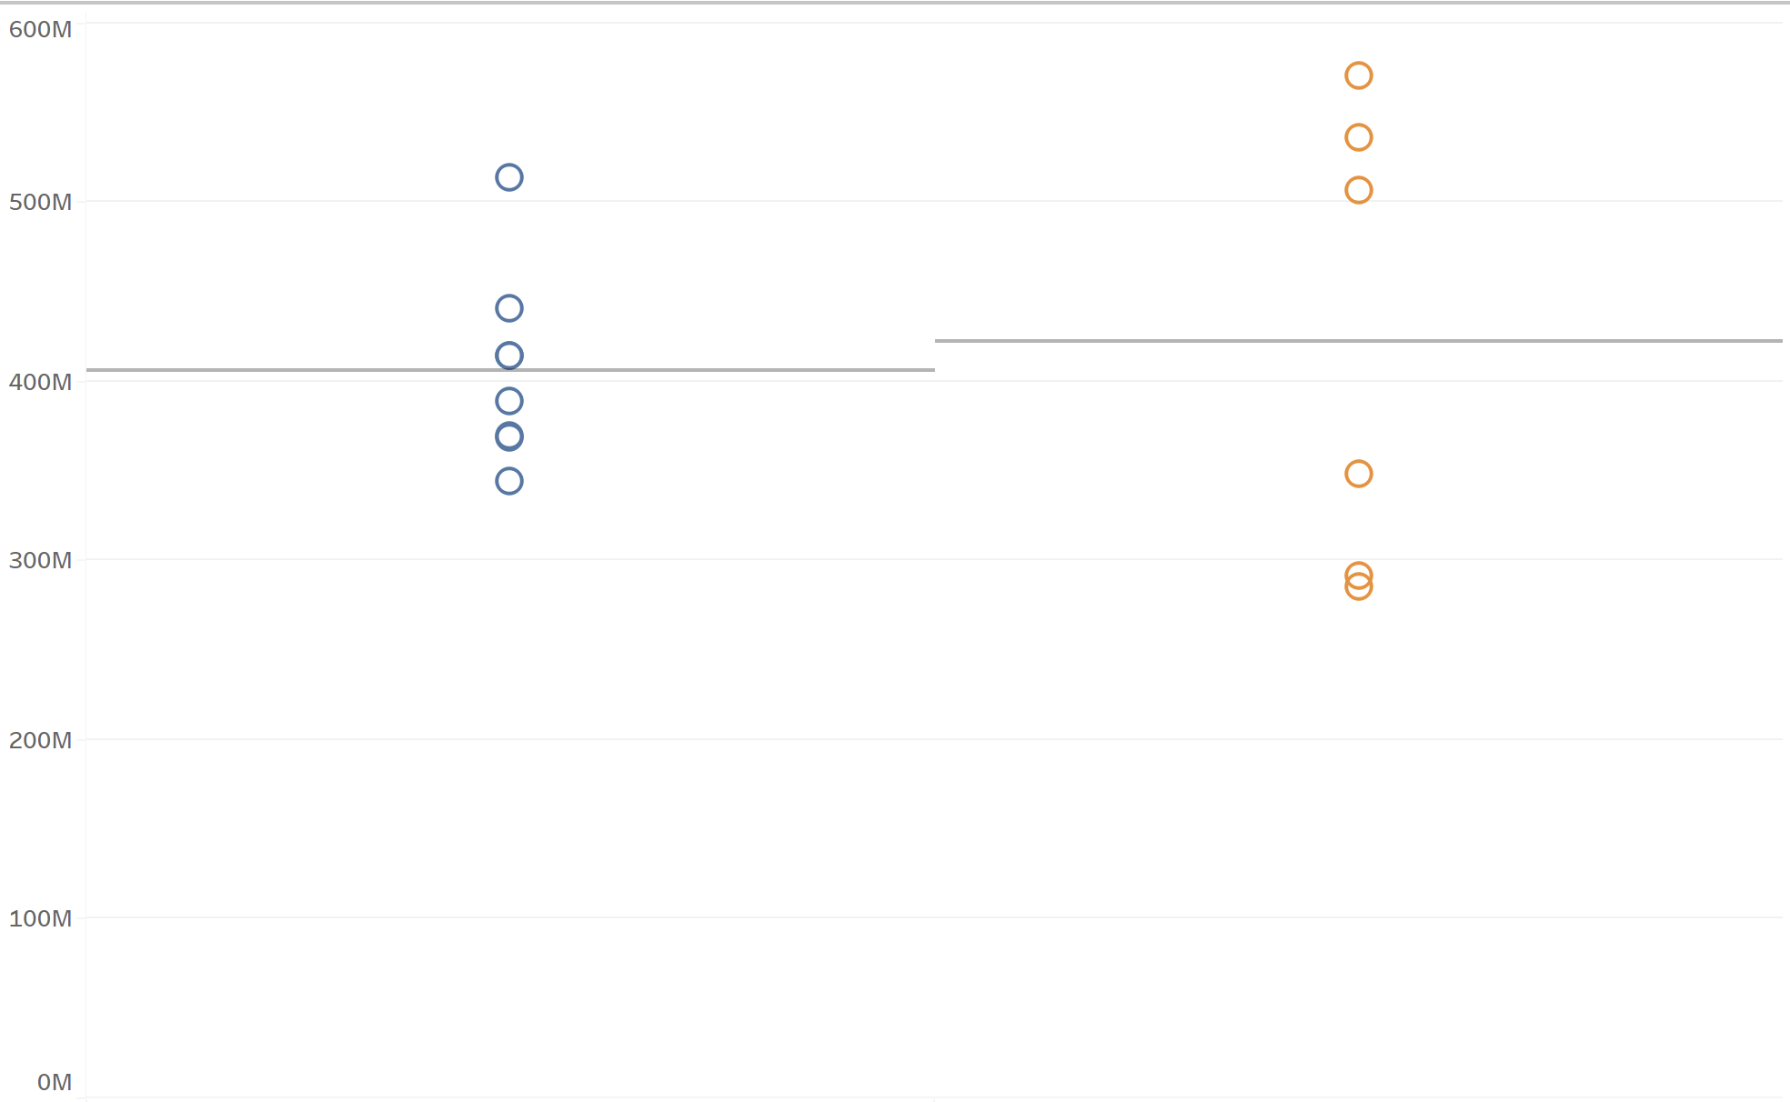


T-Test Visualization
# of Variables:
# of Groups:
Box Office
NULL HYPOTHESIS
μ_{Box-Office,HP}
₌
μ_{Box-Office,LOTR}
_{* Inflation-adjusted USD}
8

Slide 9


Scenario B
Zubin
vs.
Olivier
vs.
Fiona
9

Slide 10

Scenario B
QUESTION: Is there a difference in franchise popularity?
Groups
Zubin
Measure
Box Office Revenue
Olivier
Fiona
Proper Test :
ANOVA
10

Slide 11
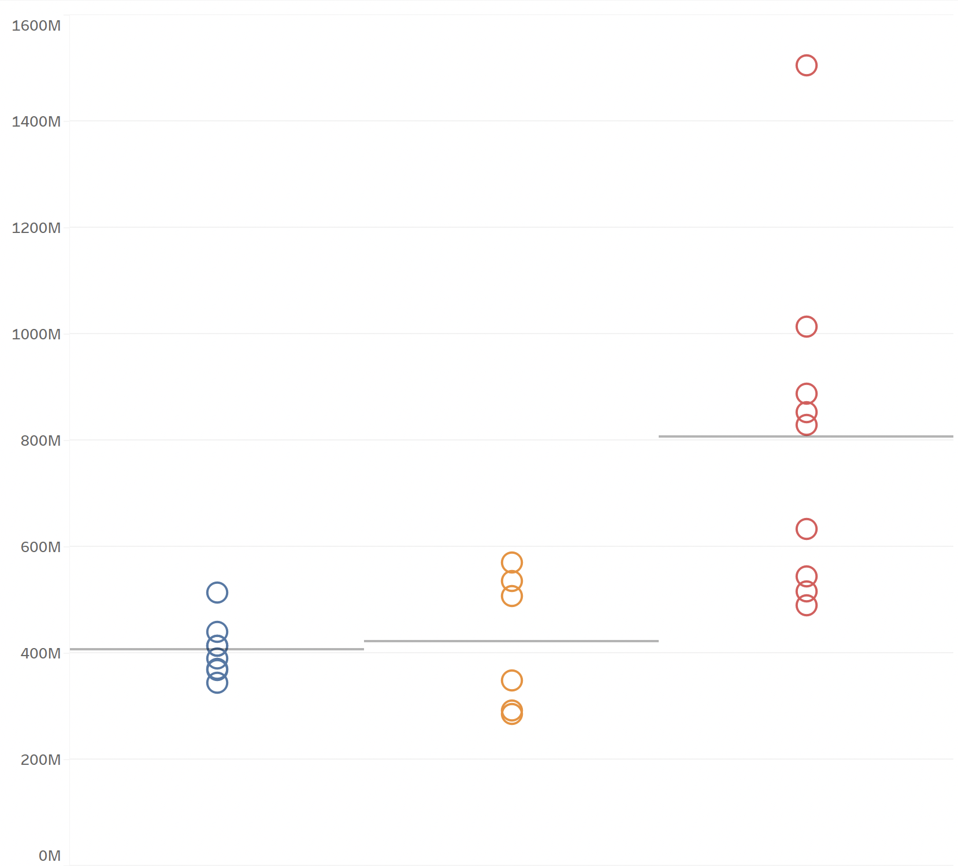

ANOVA Visualization
# of Variables:
# of Groups:
NULL HYPOTHESIS
Box Office
μ_{Box-Office,HP}
₌
μ_{Box-Office,LOTR}
₌
μ_{Box-Office,SW}
_{* Inflation-adjusted USD}
11

Slide 12

Scenario C
$$$ is not the only relevant measure.
Quality matters too!
Xingkai
12

Slide 13

Scenario C
QUESTION: Is there a difference in franchise popularity?
Groups
Zubin
Measure
IMDB Rating
Olivier
Fiona
Proper Test :
Another ANOVA??
13

Slide 14
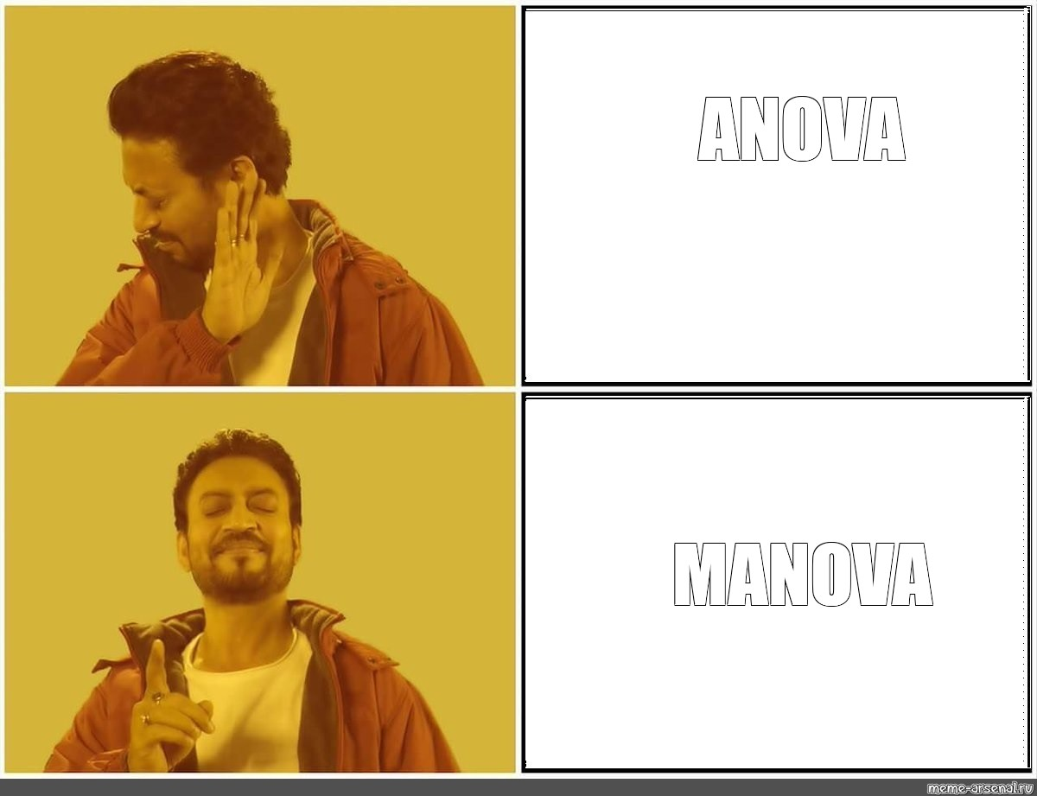
Scenario D
Xingkai
14

Slide 15
Scenario D
QUESTION: Is there a difference in franchise popularity?
Groups
Measures
Zubin
Box Office Revenue
Olivier
IMDB Rating
Fiona
Proper test:
MANOVA
15

Slide 16
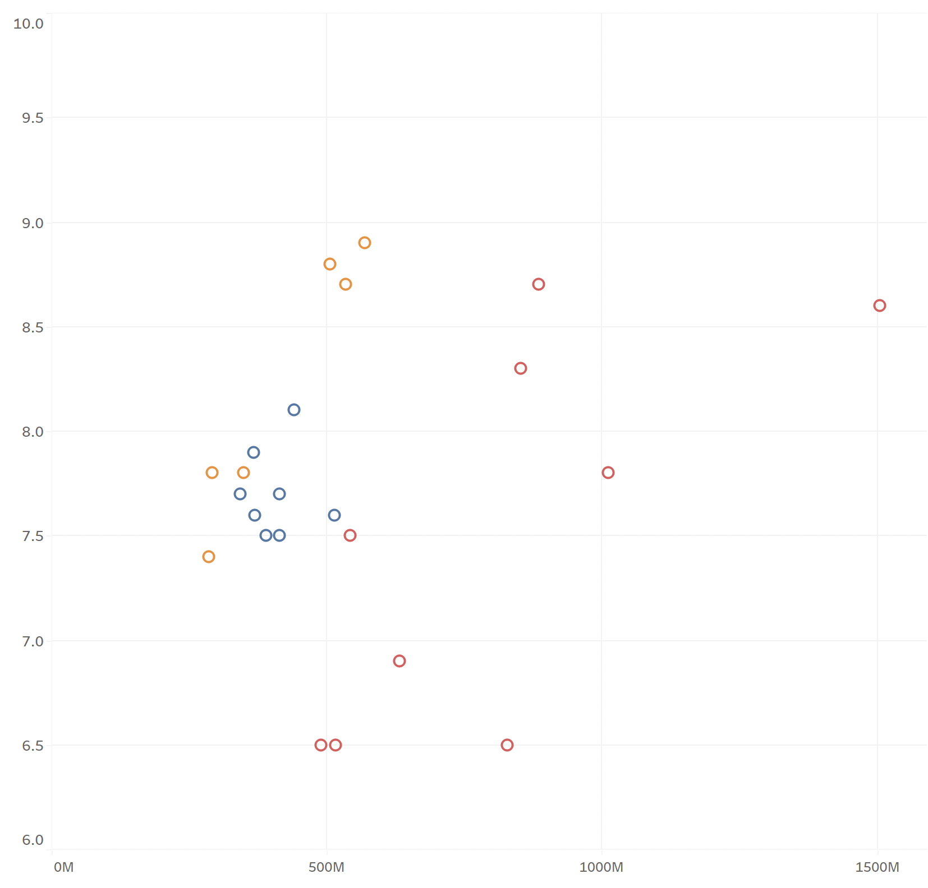
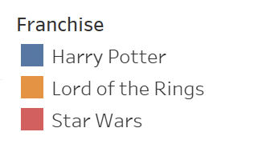
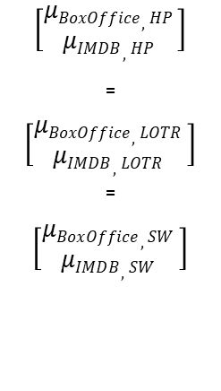
MANOVA Visualization
# of Variables:
# of Groups:
NULL HYPOTHESIS
IMDB Rating
$$\left[\begin{matrix}μBoxOffice,HP \\ μIMDB,HP \end{matrix}\right]$$
₌
$\left[\begin{matrix}μBoxOffice,LOTR \\ μIMDB,LOTR \end{matrix}\right]$
₌
$$\left[\begin{matrix}μBoxOffice,SW \\ μIMDB,SW \end{matrix}\right]$$
Box Office
_{* Inflation-adjusted USD}
16

Slide 17
03
Strengths & Limitations of MANOVA
17

Slide 18
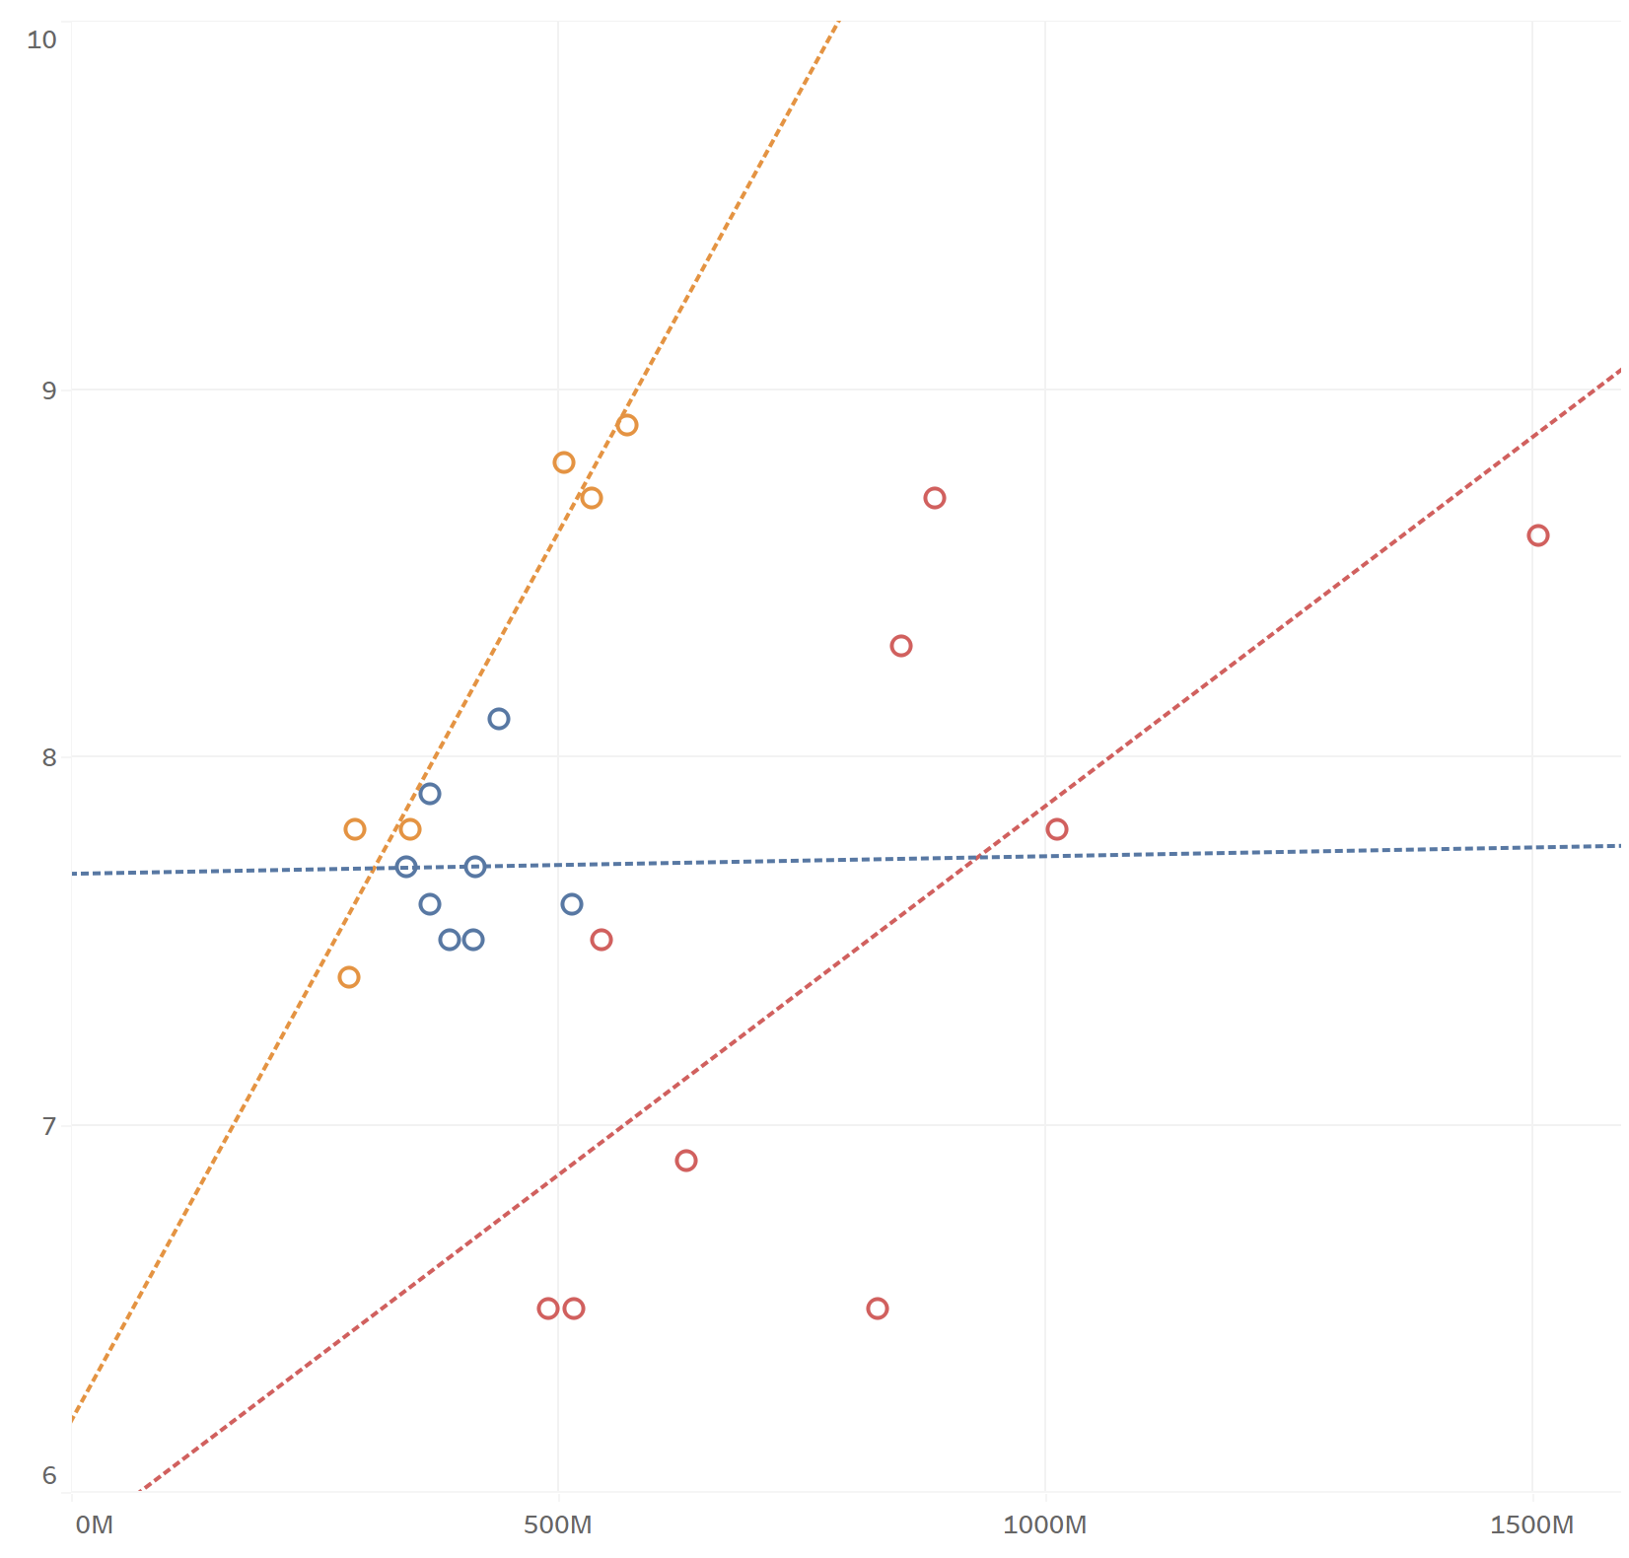
MANOVA Strength #1: Pattern Detection
Assess patterns between multiple variables across groups simultaneously
ANOVA can only view relationships on a single dimension
IMDB Rating
Box Office
_{Inflation-adjusted USD}
User-Generated IMDB Ratings (out of 10.0)
18

Slide 19
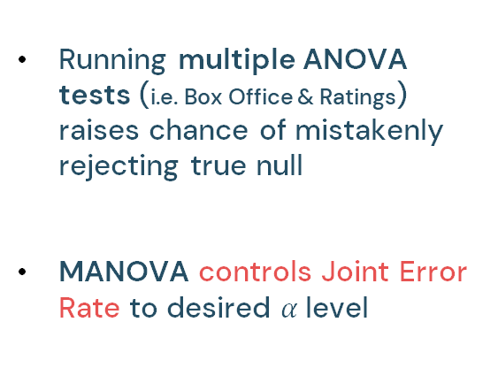
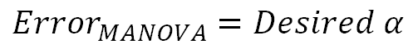
MANOVA Strength #2:
Limiting Joint Error Rate
Running multiple ANOVA tests (i.e. Box Office & Ratings) raises chance of mistakenly rejecting true null
MANOVA controls Joint Error Rate to desired $α$level
$${Error}_{ANOVA1}+{Error}_{ANOVA2}>Desired α$$
$${Error}_{MANOVA}=Desired α$$
19

Slide 20
Limitations of MANOVA
01
02
Difficult to interpret which groups show significant effects from which variables;
Requires follow-up tests for clarification
Ambiguity
Variable Correlations
Dependent variables need to be moderately correlated.
If…
Not correlated = MANOVA inappropriate
Too correlated = Multicollinearity
20

Slide 21
Thanks
Do you have any questions?
21

Slide 22
04
Appendix
22

Slide 23
Assumptions
Random Sampling - Data should be randomly sampled and the measured response variables should be continuous.
Multivariate Normality – Response variables are multivariate normally distributed within each group.
Independence – Each observation is randomly and independently sampled from the population.
Equal Variance – The population covariance matrices of each group are equal.
No Multivariate Outliers – There are no extreme multivariate outliers.
Linearity - All the dependent variables should be linearly related to each other for each group.
23

Slide 24
05
References
24

Slide 25
Frost, J. (2021, September 17). Multivariate anova (MANOVA) benefits and when to use it. Statistics By Jim. Retrieved February 7, 2022, from https://statisticsbyjim.com/anova/multivariate-anova-manova-benefits-use/
Harland, B. (2020, July 14). The advantages of MANOVA OVER ANOVA. eHow UK. Retrieved February 6, 2022, from https://www.ehow.co.uk/info_8291160_advantages-manova-over-anova.html
Korstanje, J. (2021, December 19). Manova- Deep-dive into MANOVA with worked-out examples in R and Python. Medium. Retrieved February 5, 2022, from https://towardsdatascience.com/manova-97e675a96158
Rme. (2020, October 16). Manova and Mancova. University of Miami. Retrieved February 6, 2022, from https://sites.education.miami.edu/statsu/2020/10/16/manova-and-mancova/
Сomics meme: "ANOVA MANOVA". Meme. (n.d.). Retrieved February 6, 2022, from https://www.meme-arsenal.com/en/create/meme/1635836
Zach. (2021, August 3). The Complete Guide: How To Check Manova Assumptions. Statology. Retrieved February 7, 2022, from https://www.statology.org/manova-assumptions/
Checking the additional assumptions of a Manova. Statistics Solutions. (2021, August 11). Retrieved February 7, 2022, from https://www.statisticssolutions.com/checking-the-additional-assumptions-of-a-manova/#:~:text=Linearity%20assumes%20that%20all%20of,group%20of%20the%20MANOVA%20separately.
25

